Slide 1
British Airways Trip Verification Classification
Data Science Approach for Operational Efficiency

Slide 2
Introduction
Objective: Develop a machine learning model to classify verified and non-verified trips.
Business Impact:
Enhance fraud detection.
Improve operational efficiency.
Reduce financial losses.
Data Source: British Airways trip records.

Slide 3
Dataset Overview
Total Reviews: 999
Features: Passenger details, flight details, payment method, travel history, etc.
Target Variable: Verified (1) / Non-Verified (0)
Challenges:
Class imbalance.
Missing values.
Text-based attributes requiring preprocessing.

Slide 4
Exploratory Data Analysis (EDA)
Key Findings:
Distribution of verified vs. non-verified trips.
Most influential features.
Trends and anomalies in the dataset.
Visuals:
Histogram of trip verification status.
Feature correlation heatmap.
Box plots to detect outliers.

Slide 5
Data Cleaning & Preprocessing
Handling Missing Values: Imputation techniques applied.
Feature Selection: Dropped redundant columns.
Standardization: Normalized numerical features.
Text Cleaning:
Tokenization
Stopword Removal
Stemming/Lemmatization

Slide 6
Feature Engineering
Created New Features:
Frequency of travel.
Past trip verification trends.
Payment method reliability score.
Feature Encoding:
One-hot encoding for categorical variables.
Label encoding for ordinal variables.

Slide 7
Model Selection & Training
Algorithm Used: XGBoost Classifier
Hyperparameter Tuning: Grid Search applied to optimize:
Number of estimators
Learning rate
Maximum depth
Subsampling rate
Class Imbalance Handling: SMOTE (Synthetic Minority Over-sampling Technique) applied.

Slide 8
Model Performance Metrics (Before Fine-Tuning)
Accuracy: 0.705
Precision: 0.665
Recall: 0.705
F1 Score: 0.677

Slide 9
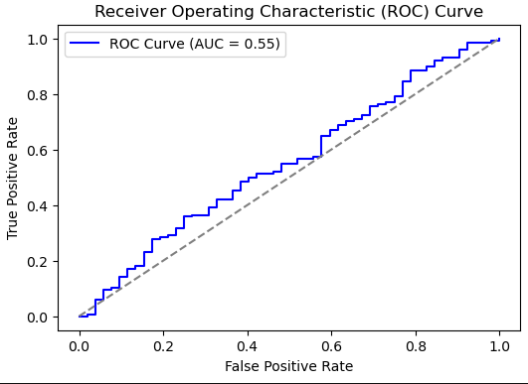
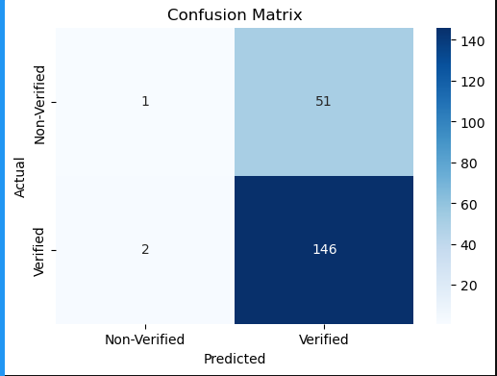
Confusion Matrix Visualization & ROC Curve & AUC Score:

Slide 10
Model Performance Metrics (After Fine-Tuning & Resampling)
Updated Accuracy: 0.765
Updated Precision: 0.762
Updated Recall: 0.993
Updated F1 Score: 0.862

Slide 11
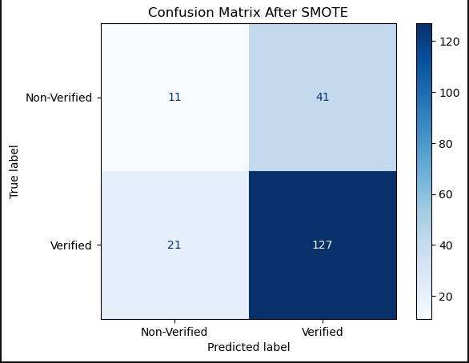
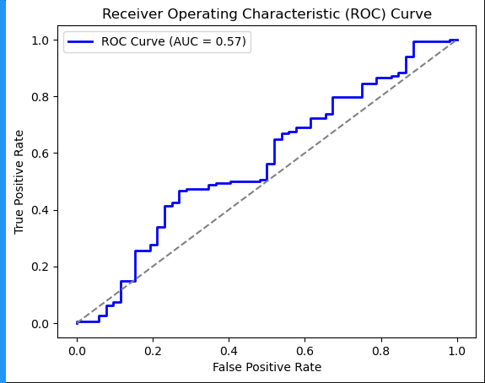
New Confusion Matrix & ROC Curve:

Slide 12
Business Impact & Recommendations
Impact on British Airways:
Improved fraud detection capabilities.
More efficient trip validation process.
Potential cost savings in fraudulent claims prevention.
Future Work:
Explore deep learning models for further accuracy improvement.
Implement real-time fraud detection system.
Integrate with British Airways' customer database for automation

Slide 13
Conclusion
Summary of Project:
Data preprocessing and cleaning steps.
Model selection, training, and optimization.
Key results and business impact.
Final Thoughts:
The model provides a solid foundation for improving trip verification.
Next steps involve deployment and further refinement.

Slide 14
Thank You!
Questions?

